Slide 1

Franchise as Another Form of Ownership

Slide 2

What is a Franchise
Cost to owning a Franchise
Explain the advantages and disadvantages of franchising
Importance of a Franchise Disclosure Document
What is a Franchise Agreement

Slide 3

When you imagine starting a new business, the process of developing your own business idea and the ownership type can be daunting.
What three type of ownership have we learned about?
- Sole Proprietorship
- Partnership
- Corporations
Another Great Option for you is a Franchise.

Slide 4


Table Talk Activity
What is a Franchise?
Discuss at your table for 1 minute.
Mrs. Vetter will call on one or more table to respond.

Slide 5

What is a Franchise?
Franchise: a licensing arrangement under which an owner licenses its operations in a set location —along with its name, trademark, products, branding, marketing and knowledge—in exchange for a franchise fee.

Slide 6
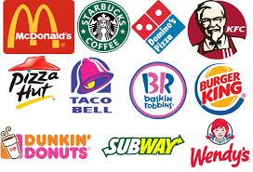

What is a Franchise?
A type of business ownership
Franchising allows you to launch a new business with the support of a successful brand and backed by a proven business model

Slide 7
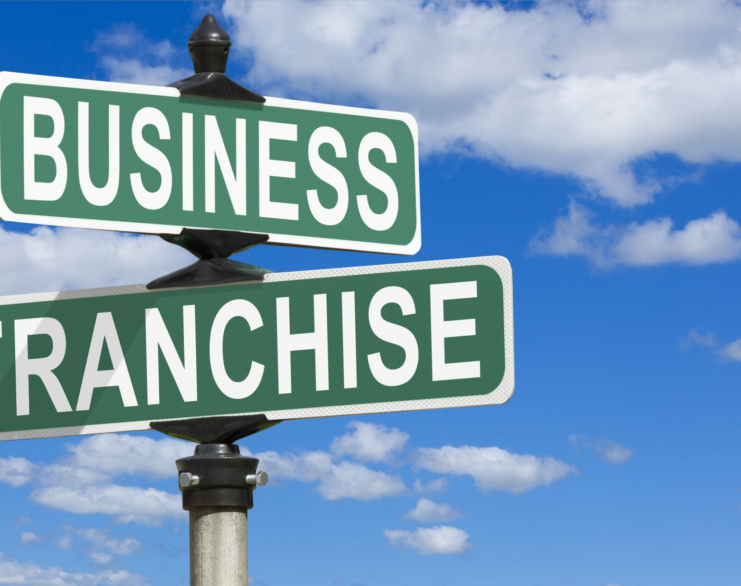
Key Players of a Franchise
Franchisor: The company that owns the overall brand and business model
Franchisee: The individual or group that buys the right to open a franchise location

Slide 8

How Does a Franchise Work?
Franchisor provides:
Brand name
Business model
Training and support
Franchisee provides:
Initial investment
Ongoing fees
Day-to-day management

Slide 9
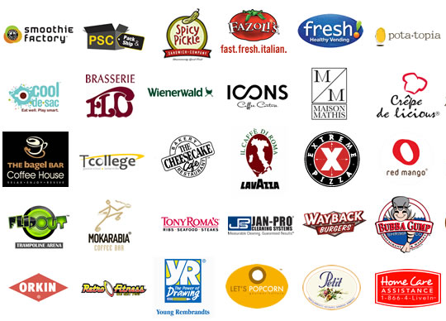
While franchises are usually associated with restaurants, any kind of business can be operated as a franchise. Some examples are:
Fast Food: McDonald's, Subway, Burger King
Retail: 7-Eleven, The UPS Store
Hotels: Marriott, Hilton
Services: H&R Block, Jiffy Lube

Slide 10

McDonald’s as a Franchise
Go to Ed puzzle posted on Google Classroom and complete the video on How much money you can make if you owned the McDonald’s franchise.

Slide 11
Steps to Become a Franchisee
Research different franchise opportunities
Review the Franchise Disclosure Document (FDD)
Speak with current and former franchisees
Secure financing
Sign the franchise agreement
Complete training
Open your franchise location

Slide 12
How Do You Set Up a Franchise?
Two Documents Required:
Franchise Disclosure Document
Franchise Agreement

Slide 13
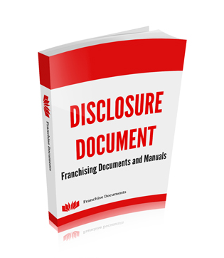
Franchise Disclosure Document (FDD): a detailed description of all aspects of a franchise and the agreement
Must be provided to the franchisee at least 14 calendar days before the franchise agreement is signed
Details virtually every aspect of the franchise agreement
A Must read for anyone thinking about entering into a franchise agreement to know all the facts before signing the dotted line

Slide 14
Key components of a Franchise Agreement
Terms and Conditions
Fees and Other Payments
Training and Support
Specific Operational Requirements
Conflict Resolution
Assigned Territory
Franchise Agreement: the contractual arrangement between a franchisor and franchisee that spells out the duties and responsibilities of both parties

Slide 15
Fees and Other Payments - The fees the franchisee must pay to use the franchisor’s products and methods, and when payments are due
1 Initial Franchise Fee
One-time payment to join the franchise system
2 Ongoing Royalty Fees
Regular payments based on a percentage of sales
3 Marketing or Advertising Fees
Contribute to national or regional marketing efforts

Slide 16
Advantages of Franchising
For Franchisees:
Less Risk due to proven business model
Established brand recognition to attract customers
Training and support from the Franchisor
Marketing assistance from the Franchisor
For Franchisors:
Rapid expansion
Additional revenue through fees
Motivated franchisees as business owners

Slide 17
Disadvantages of Franchising
For Franchisees:
High initial costs
Ongoing fees
Limited control over business decisions
Potential for conflict with franchisor
For Franchisors:
Less control over daily operations -
Risk of brand damage from poor franchisee performance
Multiple owners located in multiple locations is challenging

Slide 18
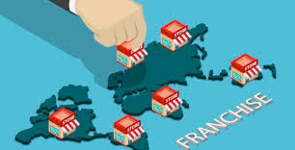
Which company do you think has the most franchise locations in the world?

Slide 19


Slide 20
Top 20 Franchises in 2023
Chic-fil-A
The UPS Store
ACE Hardware Corporation
McDonald’s
Wendy’s
Snap-on Tools
Pirtek
Matco Tools
RE/MAX
Express Employment Professionals
11. Wild Birds Unlimited
12. Century 21
13. Minuteman Press
14. Jiffy Lube
15. Budget Blinds
16. Paris Baguette
17. Papa John’s
18. The Maids
19. NOVUS Glass
20. Signarama
Notes:
Source: https://www.franchisedirect.com/information/2023-top-100-franchises-report

Slide 21



Activity: Franchise Research
Directions:
Go to Franchise.org or franchisedirect.com
Choose an industry
Select two franchises in that industry to research
Provide a brief description of what each franchise is, the cost to start it, and any requirements
Then, determine which of the two franchises you would rather open up. Explain your choice
Notes:
www.Franchise.org
www.franchisedirect.com

Slide 22
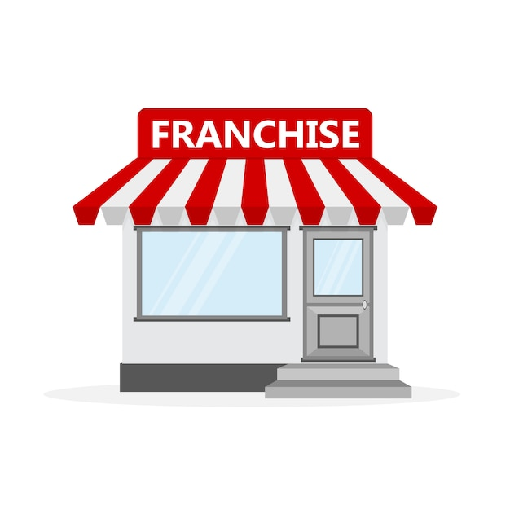
Summary
Describe one advantage and one limitation of owning a franchise.

